Slide 1
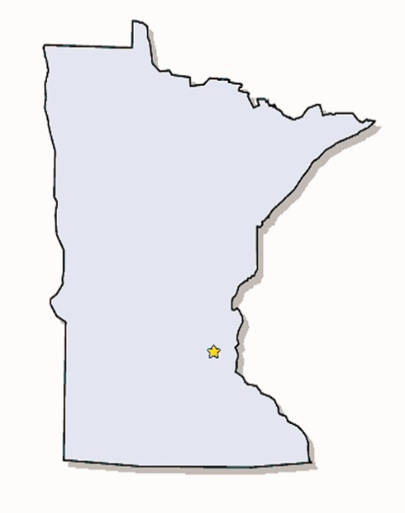
Risks
Minnesota Nurses Peer Support Network
“NURSES HELPING NURSES”
What We Do
Widespread stigma and shame among nurses about SUDs
Lack of education regarding SUDs and addiction
Positive attitude towards medications and their use
Role strain & poor self-care strategies among nurses
Problems of daily living / poor coping
Enabling by nursing peers and managers
Nurses self-diagnosing own health problems
PEER SUPPORT MEETINGS
Peer support for nurses with SUD in a safe environment with the purpose of giving hope and healing for each individual nurse.
Meetings are held throughout the state. See the NPSN website: www.npsnetwork-mn.org
Minnesota is home to more than 130,000 licensed nurses. Substance Use Disorder is a chronic disease afflicting 1 in 10 Americans. Prevalence rates are likely higher among nurses because of the high number of risk factors within professional nursing practice settings.
Mission / Vision / Values
Consequences
Mission & Vision of NPSN
Patient safety
Physical & emotional health of the nurse
Professional career of the affected nurse
Impact on nursing profession
Impact on healthcare systems
MISSION
Be a resource for all Minnesota nurses affected by substance use disorders, while fostering public safety through outreach and education.
VISION
All Minnesota nurses will have access to community-based peer support for SUD in a confidential and caring environment.
EDUCATION AND OUTREACH
Education and outreach about SUD in nursing to promote public safety and raise awareness to decrease risks in future nurses.
See the Speaker’s Bureau link on the NPSN website to schedule a presentation.
References
www.npsnetwork-mn.org
Phone: 612.508.3709
minnesotanpsnetwork@gmail.com
See us on Facebook

